Slide 1
Preparation
Start Raven.
Open Raven Mgmt http://localhost:8080/.
Open 3 examples in VS.

Slide 2
DDD, CQRS and Event Sourcing

Slide 3
Domain-Driven Design

Slide 4
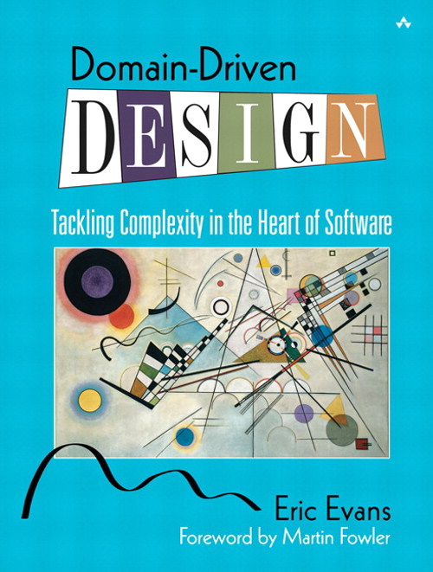

Slide 5
What is a DDD “Domain”?

Slide 6
What’s in a Domain?

Slide 7
Entities
Have “identity”.
Encapsulate data with behaviours.
No infrastructure code. None. Nada.

Slide 8
Value Objects
Don’t typically have identity.
Don’t have to be primitive types.
Consider PostalCode rather than string.
Consider immutability.

Slide 9
Entities + Value Objects = Aggregates

Slide 10
Aggregates...
Are object graphs.
Define consistency boundaries.
Contain behaviour and invariant logic.
Have an Aggregate Root.

Slide 11
Ubiquitous Language

Slide 12
A word of warning...

Slide 13
If the only verbs in your Ubiquitous Language are Create, Delete and Change, you probably should not be using DDD.

Slide 14
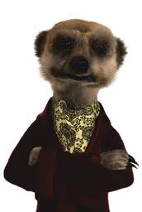
“Choose the simplest thing that could possibly work”

Slide 15
Refactoring toward deeper insight

Slide 16
?
Student
Course

Slide 17
“Data Model” Approach
?
Student
Student-Course?
Course

Slide 18
“Domain Model” Approach
✓
Student
Enrolment
Course

Slide 19
“A picture”, you say?

Slide 20
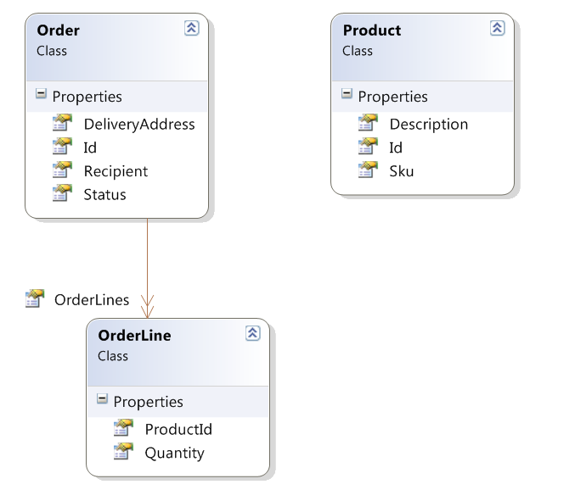

Slide 21
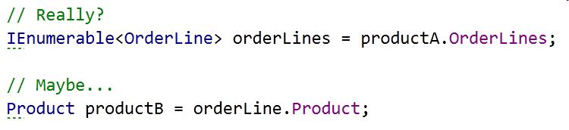

Slide 22
Application Services
Classes that coordinate behaviour of Domain Objects
DO NOT contain “business logic”
MVC controllers are probably not Application Services
Perform IoC and infrastructure duties

Slide 23
SHOW ME TEH Codez

Slide 25
CQRS

Slide 26
CQRS is really just CQS
(but at an architectural level)

Slide 27
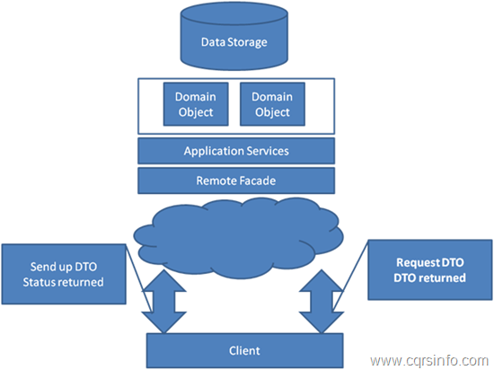
Stereotypical Architecture

Slide 28
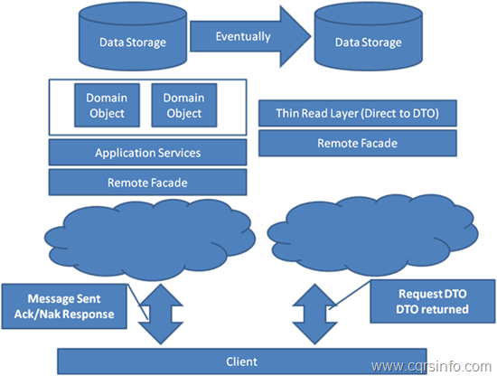
CQRS Architecture

Slide 29
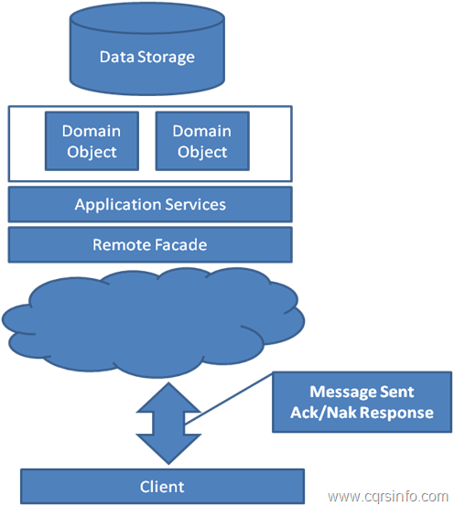
CQRS “Command Side”

Slide 30
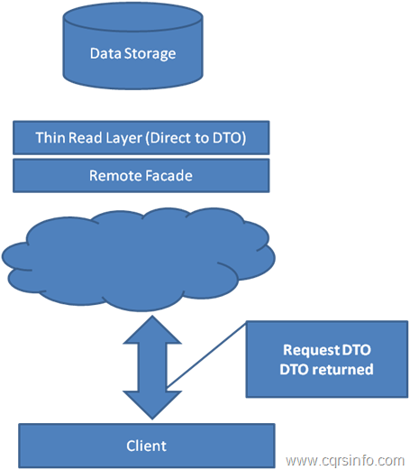
CQRS “Query Side”

Slide 31
SHOW ME TEH Codez

Slide 33
Eventual Consistency

Slide 34
You have eventual consistency if:
probably
^
You don’t have pessimistic locking
You display data on a screen
Data is in more than one place*
(* The real world is a place, too...)

Slide 35
Your DB is only what you THINK you know...

Slide 36
Don’t call it that!
It’s not “wrong”, it’s very slightly out of date

Slide 37
Why?

Slide 38
CQRS Benefits
Handles complexity well
Two models that do their jobs well
Scalability
Enables Event Sourcing...

Slide 39
Event Sourcing

Slide 40
Don’t store Entities, store the Events that got them to where they are

Slide 41
Commands and Events are different
(but both are kinds of Messages)

Slide 42
Commands
Are data structures, not objects
The name says “what”, the properties say “who, where, why, when, how” as appropriate
Present tense, imperative mood
Can fail or be rejected
Are analogous to method calls

Slide 43
Use-Case
Task
Command
Method Call

Slide 44
Events
Are data structures, not objects
The name says “what”, the properties say “who, where, why, when, how” as appropriate
Are past-tense
Cannot be failed or rejected

Slide 45
Event Sourcing Summary
Persist events not Entities
Load Events and replay in memory
Replaying bypasses invariant logic
Unit testing
Time travelling

Slide 46
CAN HAZ CODEZ

Slide 47
Resources
Eric Evans’ “Blue Book”
cqrs.wordpress.com
Greg’s 3-day course
MS P&P “CQRS Journey”
Regalo + Vita on Github
Notes:
http://codebetter.com/gregyoung/2010/02/16/cqrs-task-based-uis-event-sourcing-agh/
http://www.udidahan.com/2009/12/09/clarified-cqrs/
http://codebetter.com/gregyoung/

Slide 48
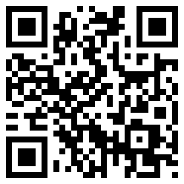

Neil Barnwell
@neilbarnwell
www.neilbarnwell.co.uk

